Slide 1


Chapter 9: Access Control Lists
Routing & Switching
Notes:
Cisco Networking Academy program
Routing & Switching
Chapter 9: Access Control Lists

Slide 2
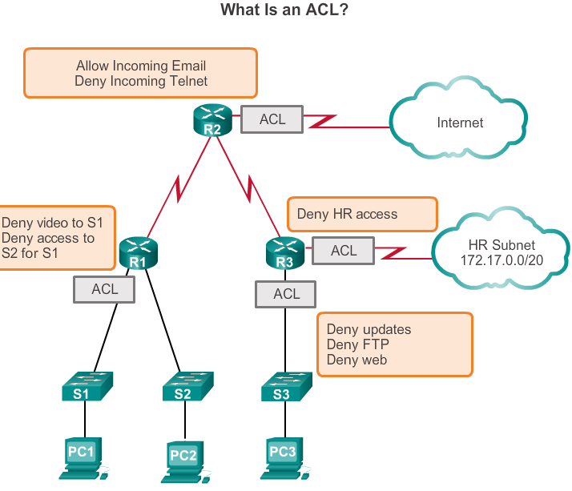
Purpose of ACLs What is an ACL?
Network security is a huge subject, and much of it is far beyond the scope of this course. However, one of the most important skills a network administrator needs is mastery of access control lists (ACLs).
An ACL is a sequential list of permit or deny statements that apply to addresses or upper-layer protocols. ACLs provide a powerful way to control traffic into and out of a network.
Basic building blocks of Firewalls
Notes:
9.1.1.1

Slide 3
Purpose of ACLs What is an ACL?
When configured, ACLs perform the following tasks:
Limit network traffic to increase network performance. For example, if corporate policy does not allow video traffic on the network, ACLs that block video traffic could be configured and applied.
Provide traffic flow control. ACLs can restrict the delivery of say routing updates. If updates are not required because of network conditions, bandwidth is preserved.
Provide a basic level of security for network access. ACLs can allow one host to access a part of the network and prevent another host from accessing the same area. For example, access to the Human Resources network can be restricted to authorized users.
Filter traffic based on traffic type. For example, an ACL can permit email traffic, but block all Telnet traffic.
Screen hosts to permit or deny access to network services. ACLs can permit or deny a user to access file types, such as FTP or HTTP.

Slide 4
Purpose of ACLs Packet Filtering
Packet filtering, sometimes called static packet filtering, controls access to a network by analyzing the incoming and outgoing packets and passing or dropping them based on given criteria, such as the source IP address, destination IP addresses, and the protocol carried within the packet.
A router acts as a packet filter when it forwards or denies packets according to filtering rules.
An ACL is a sequential list of permit or deny statements, known as access control entries (ACEs).
Notes:
9.1.1.3

Slide 5
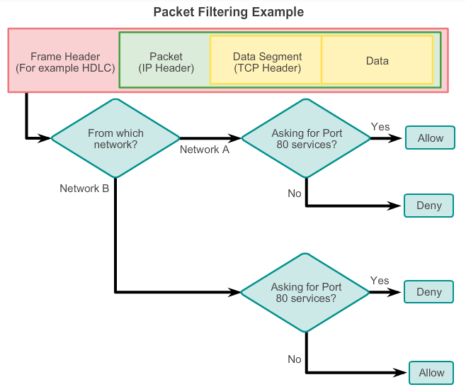
Purpose of ACLs Packet Filtering (Cont.)
For example, an ACL could be configured to logically,
"Permit web access to users from network A but deny all other services to network A users. Deny HTTP access to users from network B, but permit network B users to have all other access."
Refer to the figure to examine the decision path the packet filter uses to accomplish this task.
Notes:
9.1.1.4

Slide 6
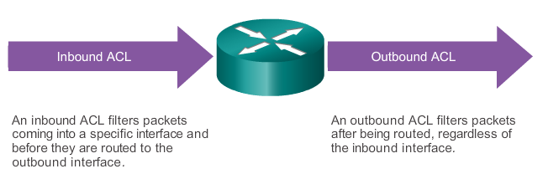
Purpose of ACLs ACL Operation
ACLs define the set of rules that give added control for packets that enter inbound interfaces, packets that relay through the router, and packets that exit outbound interfaces of the router. ACLs do not act on packets that originate from the router itself. The last statement of an ACL is always an implicit deny. This statement is automatically inserted at the end of each ACL even though it is not physically present. The implicit deny blocks all traffic. Because of this implicit deny, an ACL that does not have at least one permit statement will block all traffic.
Notes:
9.1.1.5

Slide 7
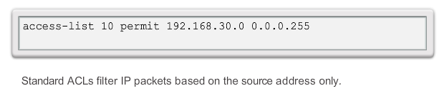
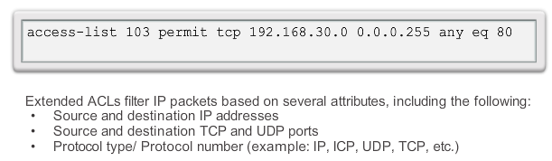
Standard versus Extended IPv4 ACLs Types of Cisco IPv4 ACLs
The two types of Cisco IPv4 ACLs are standard and extended.
Standard ACLs
Extended ACLs
Notes:
9.1.2.1

Slide 8
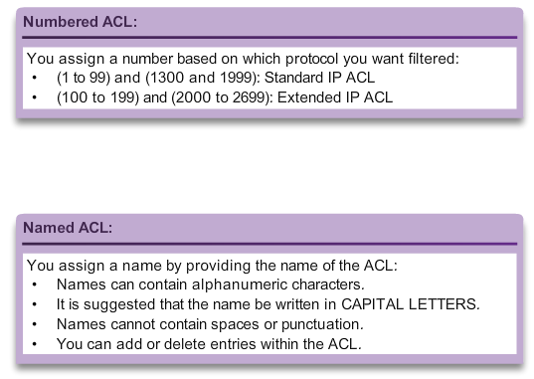
Standard versus Extended IPv4 ACLs Numbering and Naming ACLs
Standard and extended ACLs can be created using either a number or a name to identify the ACL and its list of statements.
Notes:
9.1.2.2

Slide 9
Wildcard Masks in ACLs Introducing ACL Wildcard Masking
Wildcard masks (Inverse Subnet Mask) and subnet masks differ in the way they match binary 1s and 0s. Wildcard masks use the following rules to match binary 1s and 0s:
Wildcard mask bit 0 - Match the corresponding bit value in the address.
Wildcard mask bit 1 - Ignore the corresponding bit value in the address.
Wildcard masks are often referred to as an inverse mask. The reason is that, unlike a subnet mask in which binary 1 is equal to a match and binary 0 is not a match, in a wildcard mask the reverse is true.
Notes:
9.1.3.1

Slide 10
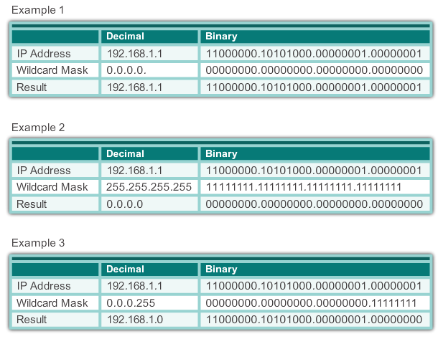
Wildcard Masks in ACLs Wildcard Mask Examples: Hosts / Subnets
Notes:
9.1.3.2

Slide 11
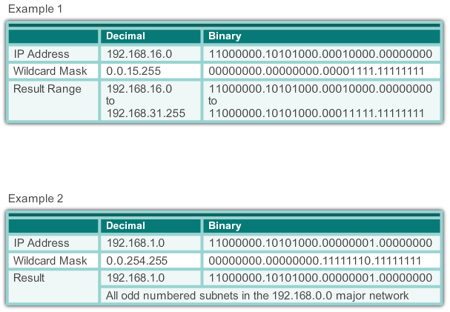
Wildcard Masks in ACLs Wildcard Mask Examples: Match Ranges
Wildcard Masks to Match IPv4 Subnets
Wildcard: 0.0.15.255 so Subnet Mask: 255.255.240.0
Notes:
9.1.3.2

Slide 12
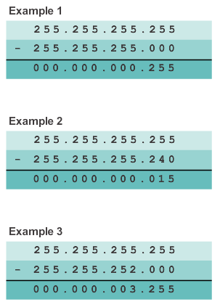
Wildcard Masks in ACLs Calculating the Wildcard Mask
Calculating wildcard masks can be challenging. One shortcut method is to subtract the subnet mask from 255.255.255.255.
Notes:
9.1.3.3

Slide 13
Wildcard Masks in ACLs Calculating the Wildcard Mask
Wildcard Mask Calculation: Example 3
Say you wanted to match only networks 192.168.10.0 and 192.168.11.0.
Again, you take the 255.255.255.255 and subtract the regular subnet mask which in this case would be 255.255.252.0. The result is 0.0.3.255.
You could accomplish the same result with statements like the two shown below:
R1(config)# access-list 10 permit 192.168.10.0
R1(config)# access-list 10 permit 192.168.11.0
It is far more efficient to configure the wildcard mask in the following way:
R1(config)# access-list 10 permit 192.168.10.0 0.0.3.255

Slide 14
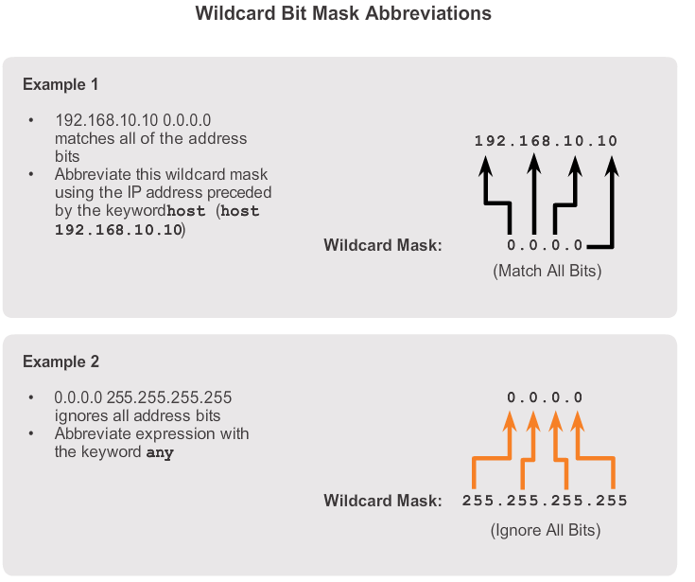
Wildcard Masks in ACLs Wildcard Mask Keywords
Working with decimal representations of binary wildcard mask bits can be tedious. To simplify this task, the keywords host and any help identify the most common uses of wildcard masking
Notes:
9.1.3.4

Slide 15
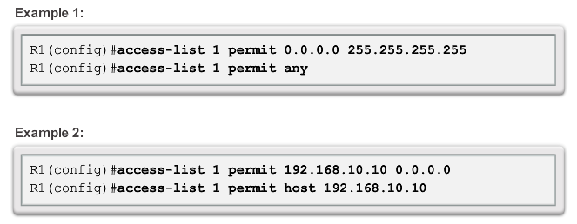
Wildcard Masks in ACLs Examples Wildcard Mask Keywords
SAME
SAME
Notes:
9.1.3.5

Slide 16
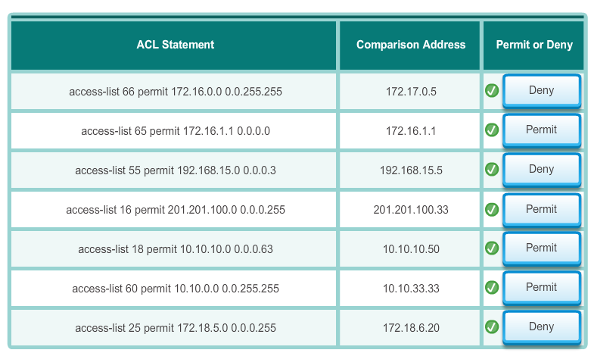
Wildcard Masks in ACLs Examples Wildcard Mask Keywords

Slide 17
Guidelines for ACL creation General Guidelines for Creating ACLs
Use ACLs in firewall routers positioned between your internal network and an external network such as the Internet.
Use ACLs on a router positioned between two parts of your network to control traffic entering or exiting a specific part of your internal network.
Configure ACLs on border routers, that is routers situated at the edges of your networks.
Configure ACLs for each network protocol configured on the border router interfaces.
Notes:
9.1.4.1

Slide 18
Guidelines for ACL creation General Guidelines for Creating ACLs
The Three Ps
One ACL per protocol - To control traffic flow on an interface, an ACL must be defined for each protocol enabled on the interface (e.g. IPv4, IPv6, IPX…).
One ACL per direction - ACLs control traffic in one direction at a time on an interface. Two separate ACLs must be created to control inbound and outbound traffic.
One ACL per interface - ACLs control traffic for an interface, for example, GigabitEthernet 0/0.
Notes:
9.1.4.1

Slide 19
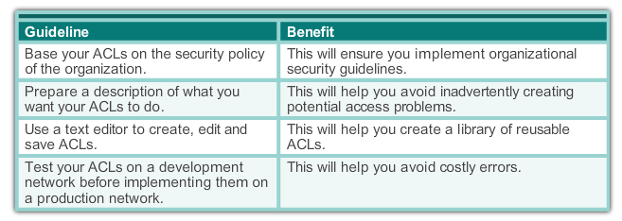
Guidelines for ACL creation ACL Best Practices
Using ACLs requires attention to detail and great care. Mistakes can be costly in terms of downtime, troubleshooting efforts, and poor network service. Before configuring an ACL, basic planning is required.
Notes:
9.1.4.2

Slide 20
Guidelines for ACL Placement Where to Place ACLs
Every ACL should be placed where it has the greatest impact on efficiency. The basic rules are:
Extended ACLs: Locate extended ACLs as close as possible to the source of the traffic to be filtered.
Standard ACLs: Because standard ACLs do not specify destination addresses, place them as close to the destination as possible.
Placement of the ACL and therefore the type of ACL used may also depend on: the extent of the network administrator’s control, bandwidth of the networks involved, and ease of configuration.
Notes:
9.1.5.1

Slide 21
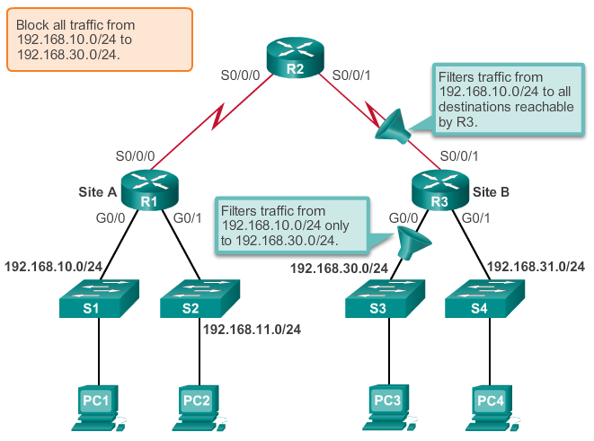
Guidelines for ACL Placement Standard ACL Placement
Example the administrator wants to prevent traffic originating in the 192.168.10.0 network from reaching the 192.168.30.0
Applying a standard ACL to prevent traffic from 192.168.10.0/24 from entering the S0/0/1 interface will prevent this traffic from reaching 192.168.30.0/24 and all other networks reachable by R3. This includes the 192.168.31.0/24 network. Because the intent of the ACL is to filter traffic destined only for 192.168.30.0/24, a standard ACL should not be applied to this interface.
If the standard ACL is placed on the outbound interface of R1, this would prevent traffic on the 192.168.10.0/24 network from reaching any networks reachable through the Serial 0/0/0 interface of R1.
Applying the standard ACL to traffic exiting the G0/0 interface will filter packets from 192.168.10.0/24 to 192.168.30.0/24. This will not affect other networks reachable by R3. Packets from 192.16810.0/24 will still be able to reach 192.168.31.0/24.
Notes:
9.1.5.2

Slide 22
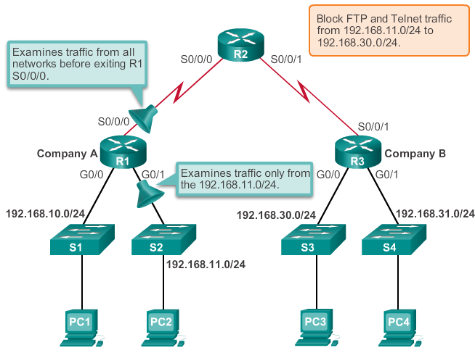
Guidelines for ACL Placement Extended ACL Placement
The administrator wants to deny Telnet and FTP traffic from the .11 network to Company B’s 192.168.30.0 network. At the same time, all other traffic from the .11 network must be permitted to leave Company A without restriction.
One possibility is to apply an extended ACL outbound on the S0/0/0 interface. Because the extended ACL can examine both source and destination addresses, only FTP and Telnet packets from 192.168.11.0/24 will be denied. Other traffic from 192.168.11.0/24 and other networks will be forwarded by R1. The disadvantage of placing the extended ACL on this interface is that all traffic exiting S0/0/0 must be processed by the ACL including packets from 192.168.10.0/24.
Applying an extended ACL to traffic entering the G0/1 interface means that only packets from the 192.168.11.0/24 network are subject to ACL processing on R1. Because the filter is to be limited to only those packets leaving the 192.168.11.0/24 network, applying the extended ACL to G0/1 is the best solution.
Notes:
9.1.5.3

Slide 23
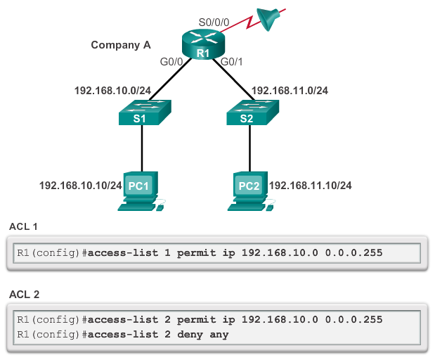
Configure Standard IPv4 ACLs Entering Criteria Statements
When traffic enters the router, the traffic is compared to all ACEs in the order that the entries occur in the ACL.
The router continues to process the ACEs until it finds a match.
The router will process the packet based on the first match found and no other ACEs will be examined.
If no matches are found when the router reaches the end of the list, the traffic is denied. This is because, by default, there is an implied deny at the end of all ACLs for traffic that was not matched to a configured entry.
A single-entry ACL with only one deny entry has the effect of denying all traffic. At least one permit ACE must be configured in an ACL or all traffic is blocked.
For the network in the figure, applying either ACL 1 or ACL 2 to the S0/0/0 interface of R1 in the outbound direction will have the same effect.
Notes:
9.2.1.1

Slide 24
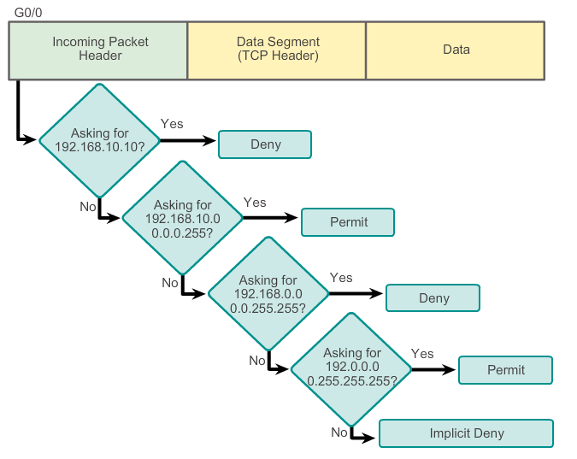
Configure Standard IPv4 ACLs Configuring a Standard ACL
Example ACL
access-list 2 deny host 192.168.10.10
access-list 2 permit 192.168.10.0 0.0.0.255
access-list 2 deny 192.168.0.0 0.0.255.255
access-list 2 permit 192.0.0.0 0.255.255.255
Notes:
9.2.1.2

Slide 25
Configure Standard IPv4 ACLs Configuring a Standard ACL (Cont.)
The full syntax of the standard ACL command is as follows:
Router(config)# access-list access-list-number deny permit remark source [ source-wildcard ] [ log ]
To remove the ACL, the global configuration no access-list command is used.
The remark keyword is used for documentation and makes access lists a great deal easier to understand.
The log keyword sends an informational message to the console.
Notes:
9.2.1.3

Slide 26
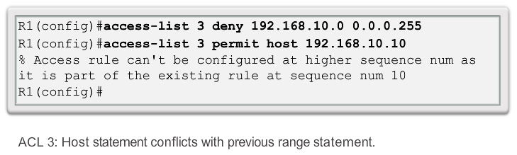
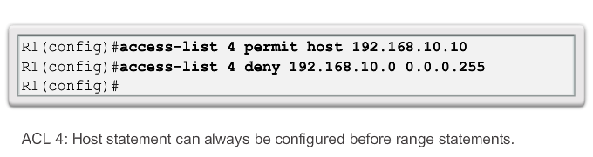
Configure Standard IPv4 ACLs Internal Logic
Cisco IOS applies an internal logic when accepting and processing standard access list statements. As discussed previously, access list statements are processed sequentially. Therefore, the order in which statements are entered is important.
Notes:
9.2.1.4

Slide 27
Configure Standard IPv4 ACLs Applying Standard ACLs to Interfaces
After a standard ACL is configured, it is linked to an interface using the ip access-group command in interface configuration mode:
Router(config-if)# ip access-group { access-list-number | access-list-name } { in | out }
To remove an ACL from an interface, first enter the no ip access-group command on the interface, and then enter the global no access-list command to remove the entire ACL.
Notes:
9.2.1.5

Slide 28
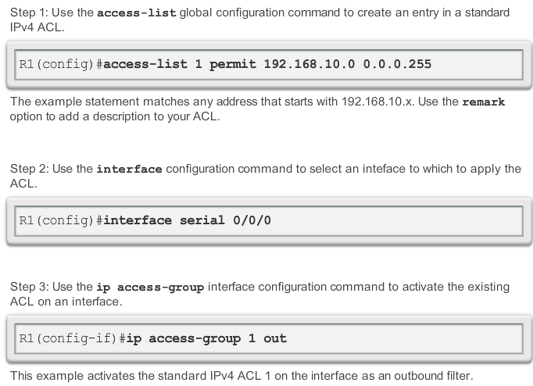
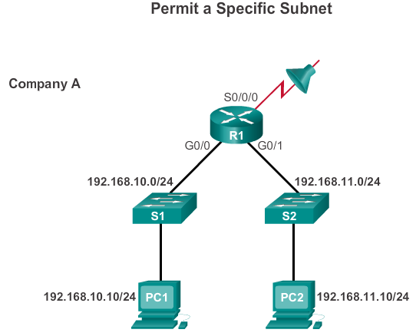
Configure Standard IPv4 ACLs Applying Standard ACLs to Interfaces (Cont.)
Notes:
9.2.1.6

Slide 29
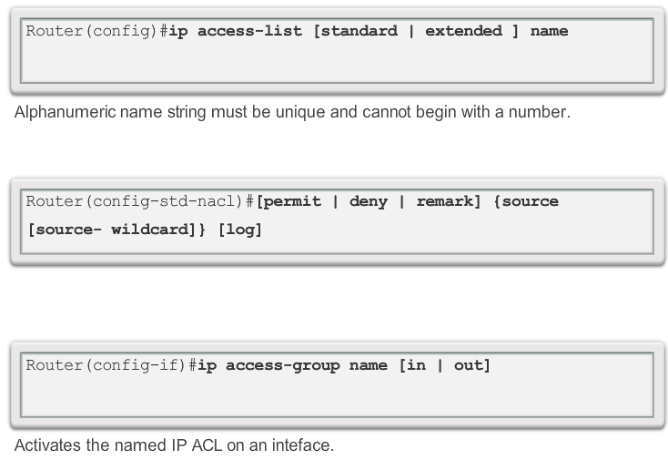
Configure Standard IPv4 ACLs Creating Named Standard ACLs
Naming an ACL makes it easier to understand its function. For example, an ACL configured to deny FTP could be called NO_FTP. When you identify your ACL with a name instead of with a number, the configuration mode and command syntax are slightly different.
Notes:
9.2.1.7

Slide 30
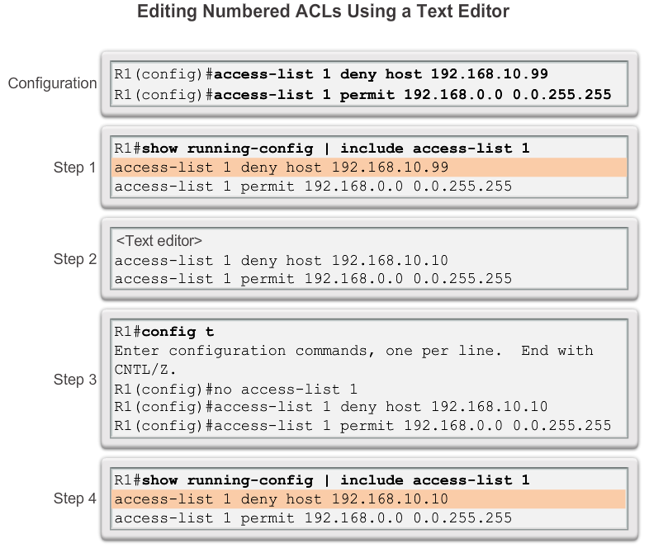
Modify IPv4 ACLs Editing Standard Numbered ACLs
When configuring a standard ACL, the statements are added to the running-config.
However, there is no built-in editing feature that allows you to edit a change in an ACL.
There are two ways that a standard numbered ACL can be edited.
Method 1: Using a Text Editor
Use a text editor such as Notepad. This allows you to create or edit the ACL and then paste it into the router.
Notes:
9.2.2.1

Slide 31
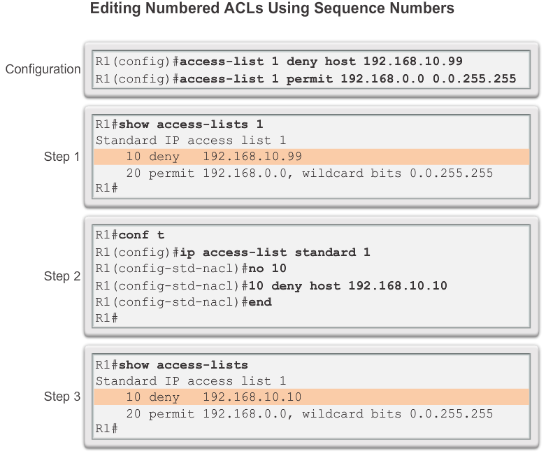
Modify IPv4 ACLs Editing Standard Numbered ACLs (Cont.)
Method 2: Using the Sequence Number
Notes:
9.2.2.2

Slide 32
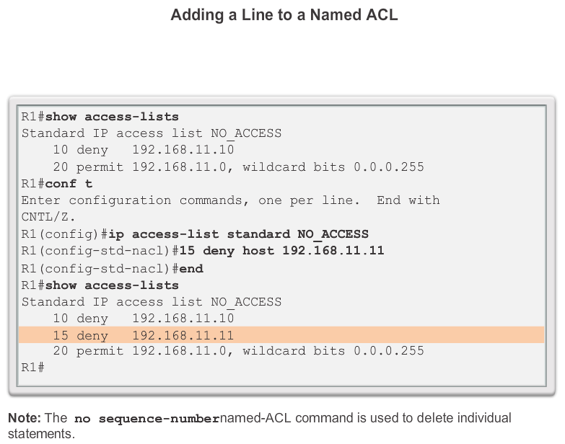
Modify IPv4 ACLs Editing Standard Named ACLs
Notes:
9.2.2.3

Slide 33
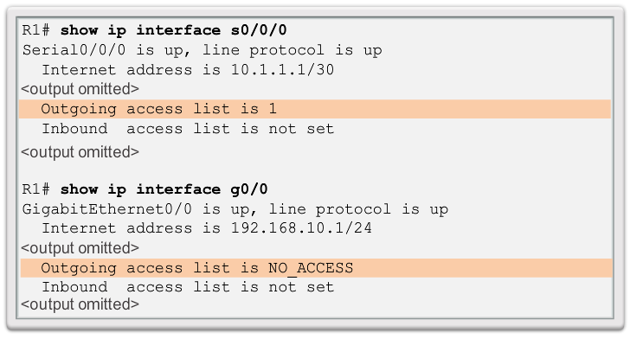
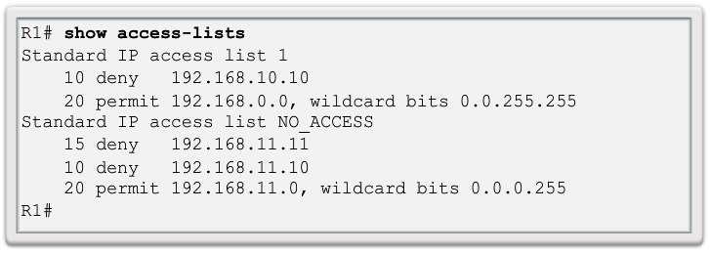
Modify IPv4 ACLs Verifying ACLs
The output from this command includes the number or name of the access list and the direction in which the ACL was applied
To view an individual access list use the show access-lists command followed by the access list number or name.
Notes:
9.2.2.5

Slide 34
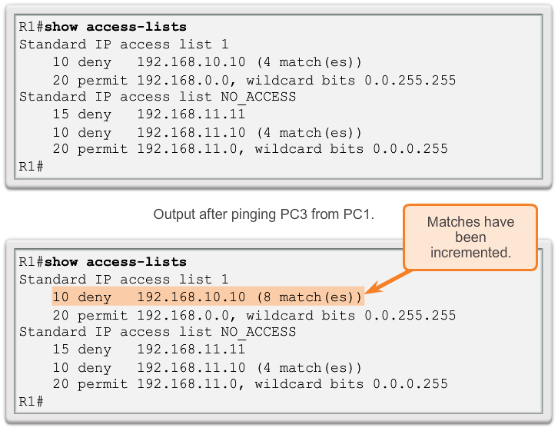
Modify IPv4 ACLs ACL Statistics
Once the ACL has been applied to an interface and some testing has occurred, the show access-lists command will show statistics for each statement that has been matched.
Notes:
9.2.2.6

Slide 35
Securing VTY ports with a Standard IPv4 ACL Configuring a Standard ACL to Secure a VTY Port
Filtering Telnet or SSH traffic is typically considered an extended IP ACL function because it filters a higher level protocol. However, because the access-class command is used to filter incoming or outgoing Telnet/SSH sessions by source address, a standard ACL can be used.
Router(config-line)# access-class access-list-number { in [ vrf-also ] | out }
Notes:
9.2.3.1

Slide 36
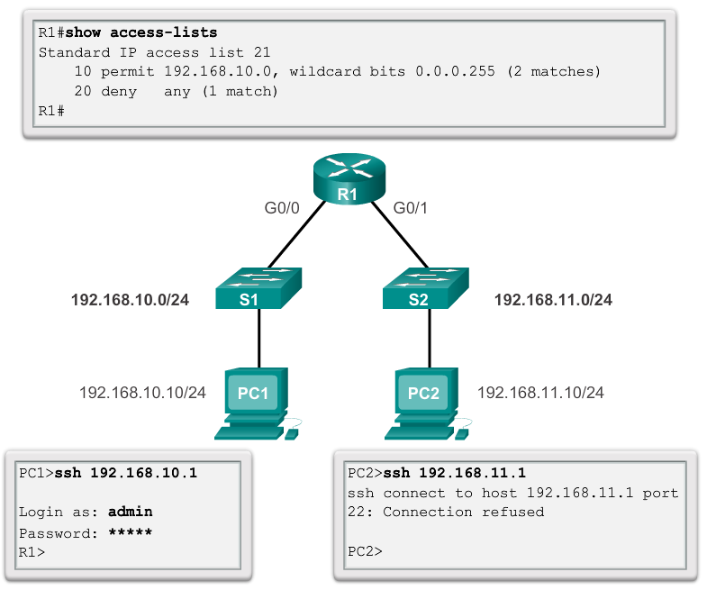
Securing VTY ports with a Standard IPv4 ACL Verifying a Standard ACL used to Secure a VTY Port
The figure shows two devices attempting to connect to R1 using SSH. Access list 21 has been configured on the VTY lines on R1. PC1 is successful while PC2 fails.
Notes:
9.2.3.2

Slide 37
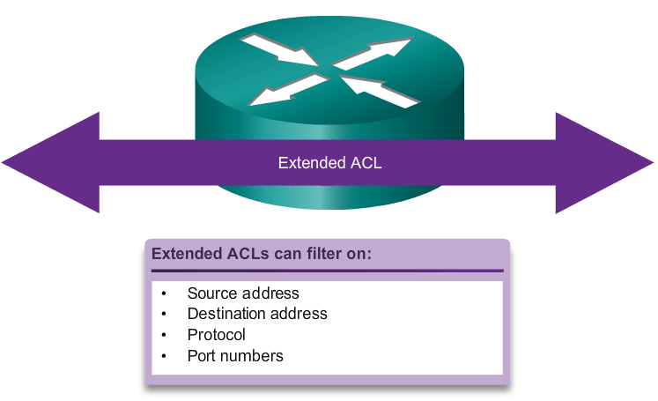
Structure of an Extended IPv4 ACL Extended ACLs
For more precise traffic-filtering control, extended IPv4 ACLs can be created
Notes:
9.3.1.1

Slide 38
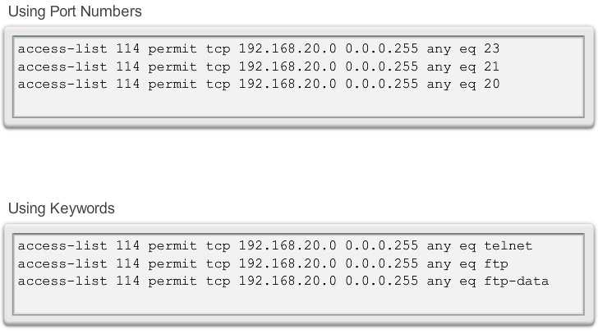
Structure of an Extended IPv4 ACL Extended ACLs (Cont.)
The ability to filter on protocol and port number allows network administrators to build very specific extended ACLs. An application can be specified by configuring either the port number or the name of a well-known port.
Logical operations can be used, such as equal (eq), not equal (neq), greater than (gt), and less than (lt).
Notes:
9.3.1.2

Slide 39
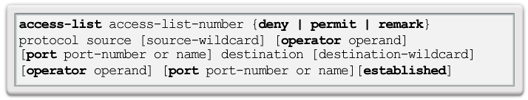
Configure Extended IPv4 ACLs Configuring Extended ACLs
The procedural steps for configuring extended ACLs are the same as for standard ACLs. The extended ACL is first configured, and then it is activated on an interface. However, the command syntax and parameters are more complex to support the additional features provided by extended ACLs.
Notes:
9.3.2.1

Slide 40
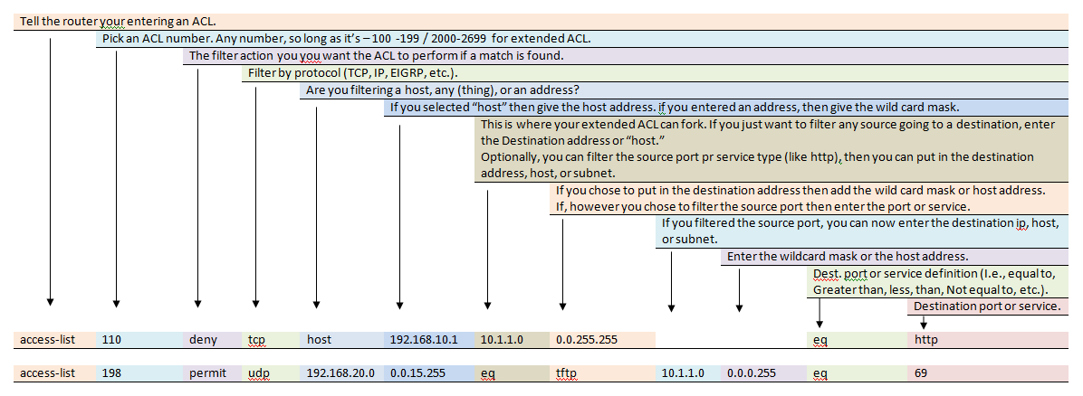

Slide 41
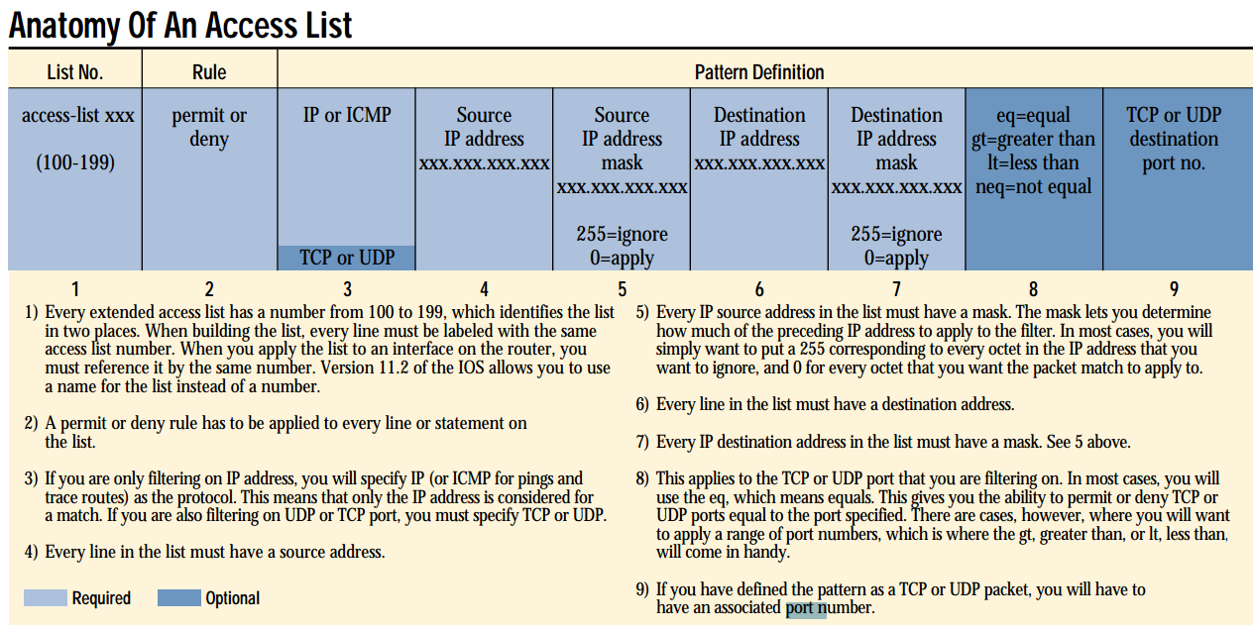

Slide 42
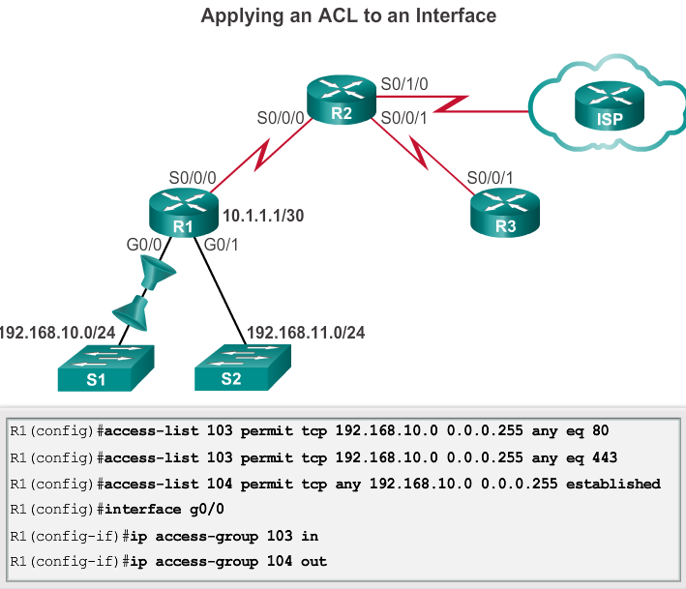
Configure Extended IPv4 ACLs Applying Extended ACLs to Interfaces
In this example, the network administrator has configured ACLs to restrict network access to allow website browsing only (no ftp, telnet email etc..) from the LAN attached to interface G0/0 to any external network.
ACL 103 allows traffic coming from any address on the 192.168.10.0 network to go to any destination, subject to the limitation that the traffic is using ports 80 (HTTP) or 443 (HTTPS) only.
ACL 104 blocks all incoming traffic, except for previously established connections by using the established parameter.
The established parameter allows only responses to traffic that originates from the 192.168.10.0/24 network to return to that network.
Remember: Extended, close to source as possible
Notes:
9.3.2.2

Slide 43
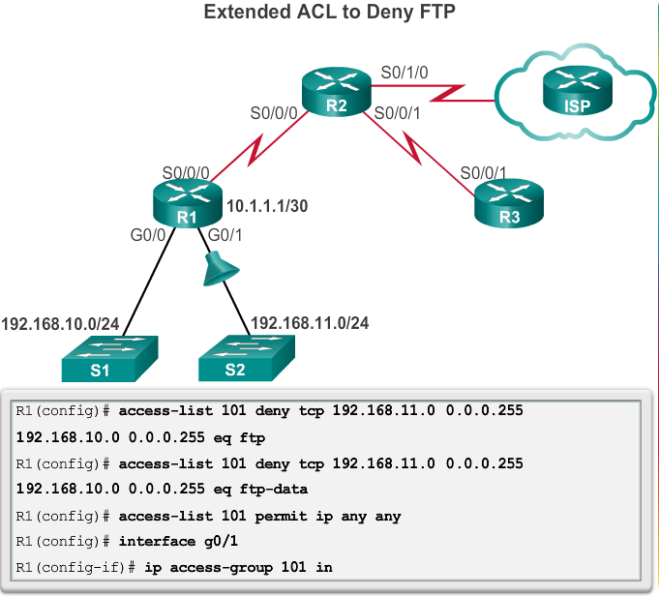
Configure Extended IPv4 ACLs Filtering Traffic with Extended ACLs
Deny FTP traffic from subnet 192.168.11.0 that is going to subnet 192.168.10.0, but permits all other traffic.
Remember that FTP uses TCP ports 20 and 21; therefore the ACL requires both port name keywords ftp and ftp-data or eq 20 and eq 21 to deny FTP.
Notes:
9.3.2.3

Slide 44
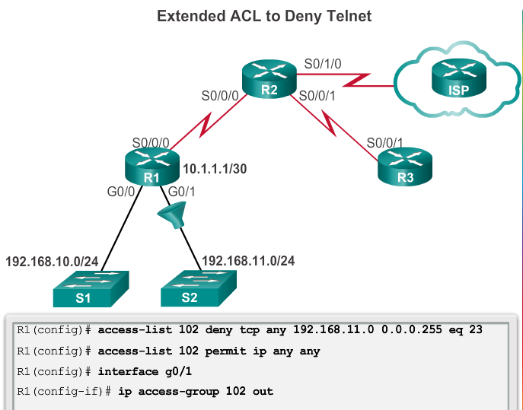
Configure Extended IPv4 ACLs Filtering Traffic with Extended ACLs
Deny Telnet traffic from any source to the 192.168.11.0/24 LAN, but allows all other IP traffic.
Because traffic destined for the 192.168.11.0/24 LAN is outbound on interface G0/1, the ACL would be applied to G0/1 using the out keyword.
Again note the use of the any keywords in the permit statement. This permit statement is added to ensure that no other traffic is blocked.

Slide 45
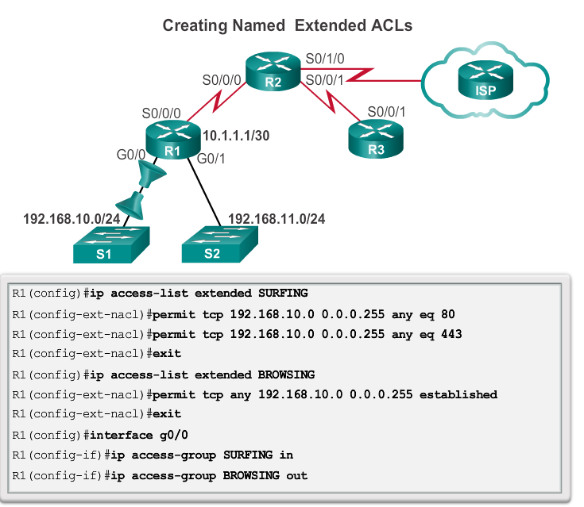
Configure Extended IPv4 ACLs Creating Named Extended ACLs
Named extended ACLs are created in essentially the same way that named standard ACLs are created. Follow these steps to create an extended ACL, using names:
Step 1. From global configuration mode, use the ip access-list extended name command to define a name for the extended ACL.
Step 2. In named ACL configuration mode, specify the conditions to permit or deny.
Step 3. Return to privileged EXEC mode and verify the ACL with the show access-lists name command.
Notes:
9.3.2.4

Slide 46
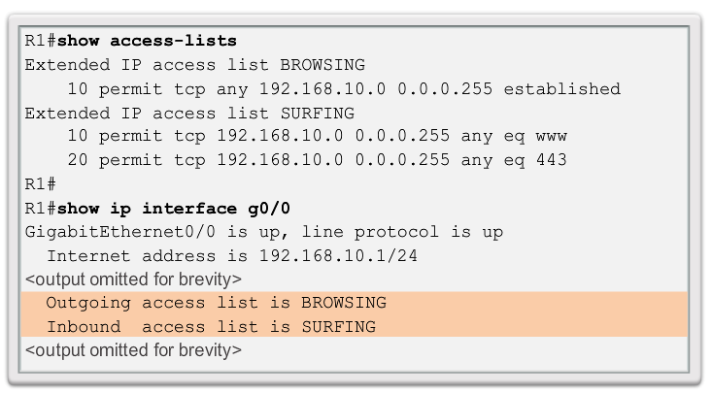
Configure Extended IPv4 ACLs Verifying Extended ACLs
Notes:
9.3.2.5

Slide 47
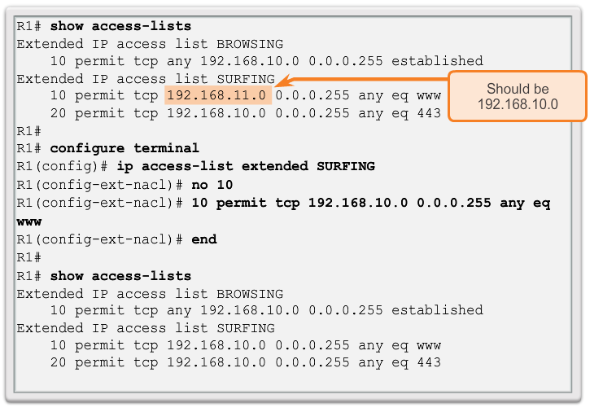
Configure Extended IPv4 ACLs Editing Extended ACLs
Editing an extended ACL can be accomplished using the same process as editing a standard. An extended ACL can be modified using:
Method 1 - Text editor
Method 2 – Sequence numbers
Activity 9.3.1.7
Notes:
9.3.2.6

Slide 48
Processing Packets with ACLs Inbound ACL Logic
Packets are tested against an inbound ACL, if one exists, before being routed.
If an inbound packet matches an ACL statement with a permit, it is sent to be routed.
If an inbound packet matches an ACL statement with a deny, it is dropped and not routed.
If an inbound packet does not meet any ACL statements, then it is “implicitly denied” and dropped without being routed.
Notes:
9.5.1.1

Slide 49
Processing Packets with ACLs Outbound ACL Logic
Packets are first checked for a route before being sent to an outbound interface. If there is no route the packets are dropped.
If an outbound interface has no ACL, then the packets are sent directly to that interface.
If there is an ACL on the outbound interface, it is tested before being sent to that interface.
If an outbound packet matches an ACL statement with a permit, it is sent to the interface.
If an outbound packet matches an ACL statement with a deny, it is dropped.
If an outbound packet does not meet any ACL statements, then it is “implicitly denied” and dropped.
Notes:
9.5.1.1

Slide 50
Processing Packets with ACLs ACL Logic Operations
When a packet arrives at a router interface, the router process is the same, whether ACLs are used or not. As a frame enters an interface, the router checks to see whether the destination Layer 2 address matches it’s the interface Layer 2 address or if the frame is a broadcast frame.
If the frame address is accepted, the frame information is stripped off and the router checks for an ACL on the inbound interface. If an ACL exists, the packet is tested against the statements in the list.
Notes:
9.5.1.2

Slide 51
Processing Packets with ACLs ACL Logic Operations (continued)
If the packet is accepted, it is then checked against routing table entries to determine the destination interface. If a routing table entry exists for the destination, the packet is then switched to the outgoing interface, otherwise the packet is dropped.
Next, the router checks whether the outgoing interface has an ACL. If an ACL exists, the packet is tested against the statements in the list.
If there is no ACL or the packet is permitted, the packet is encapsulated in the new Layer 2 protocol and forwarded out the interface to the next device.
Notes:
9.5.1.2

Slide 52
Processing Packets with ACLs Standard ACL Decision Process
Standard ACLs only examine the source IPv4 address. The destination of the packet and the ports involved are not considered.
Cisco IOS software tests addresses against the conditions in the ACL one by one. The first match determines whether the software accepts or rejects the address. Because the software stops testing conditions after the first match, the order of the conditions is critical. If no conditions match, the address is rejected.
Notes:
9.5.1.3

Slide 53
Processing Packets with ACLs Extended ACL Decision Process
The ACL first filters on the source address, then on the port and protocol of the source. It then filters on the destination address, then on the port and protocol of the destination, and makes a final permit or deny decision.
Notes:
9.5.1.4

Slide 54
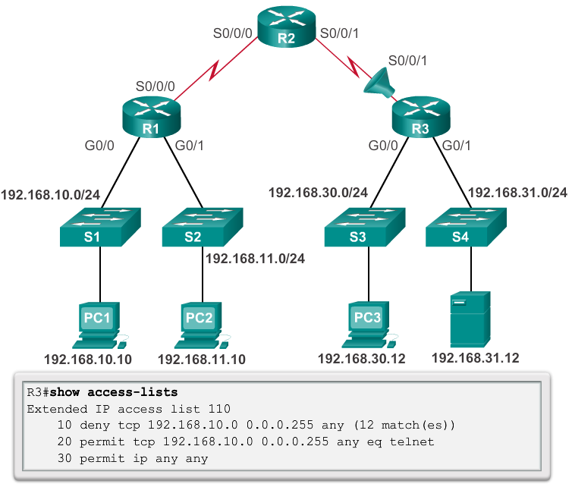
Common ACLs Errors Troubleshooting Common ACL Errors - Example 1
Host 192.168.10.10 has no connectivity with 192.168.30.12.
Solution - Look at the order of the ACEs. Host 192.168.10.10 has no connectivity with 192.168.30.12 because of the order of rule 10 in the access list. Because the router processes ACLs from the top down, statement 10 denies host 192.168.10.10, so statement 20 can never be matched. Statements 10 and 20 should be reversed. The last line allows all other non-TCP traffic that falls under IP (ICMP, UDP, etc.).
Notes:
9.5.2.1

Slide 55
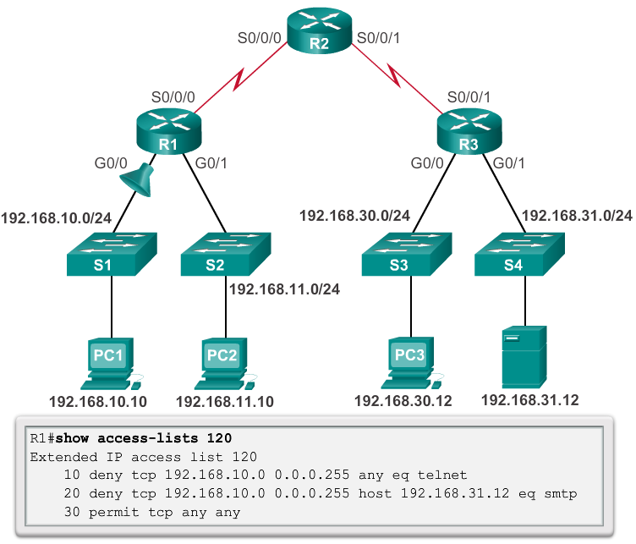
Common ACLs Errors Troubleshooting Common ACL Errors – Example 2
The 192.168.10.0 /24 network cannot use TFTP to connect to the 192.168.30.0 /24 network.
Solution - The 192.168.10.0/24 network cannot use TFTP to connect to the 192.168.30.0/24 network because TFTP uses the transport protocol UDP. Statement 30 in access list 120 allows all other TCP traffic. However, because TFTP uses UDP instead of TCP, it is implicitly denied. Recall that the implied deny any statement does not appear in show access-lists output and therefore matches are not shown.
Statement 30 should be
ip any any.
Notes:
9.5.2.2

Slide 56
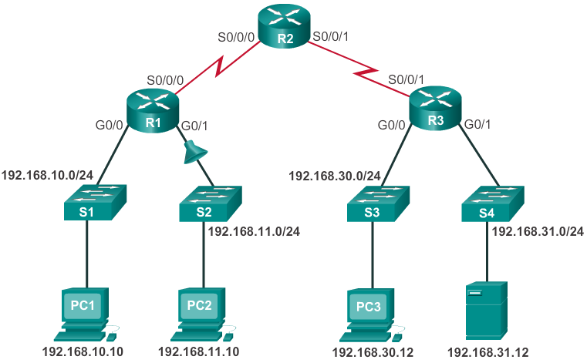
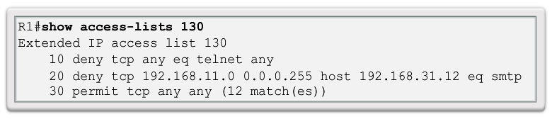
Common ACLs Errors Troubleshooting Common ACL Errors – Example 3
The 192.168.11.0 /24 network can use Telnet to connect to 192.168.30.0 /24, but according to company policy, this connection should not be allowed.
Solution - The 192.168.11.0/24 network can use Telnet to connect to the 192.168.30.0/24 network, because the Telnet port number in statement 10 of access list 130 is listed in the wrong position in the ACL statement.
Statement 10 currently denies any source packet with a port number that is equal to Telnet.
To deny Telnet traffic inbound on G0/1, deny the destination port number that is equal to Telnet, for example,
deny tcp any any eq telnet.
Notes:
9.5.2.3

Slide 57
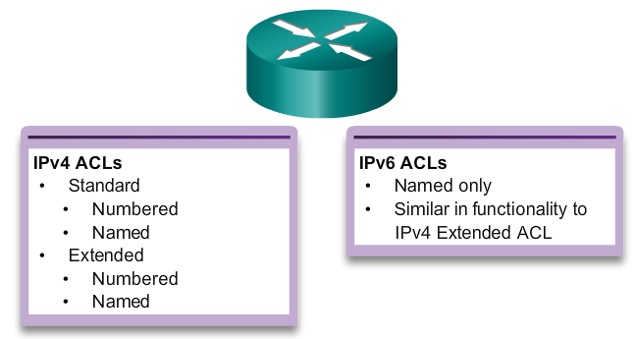
IPv6 ACL Creation Type of IPv6 ACLs
IPv6 ACLs are very similar to IPv4 ACLs in both operation and configuration.
Being familiar with IPv4 ACLs makes IPv6 ACLs easy to understand and configure.
In IPv4 there are two types of ACLs, standard and extended. Both types of ACLs can be either numbered or named ACLs.
With IPv6, there is only one type of ACL, which is equivalent to an IPv4 extended named ACL. There are no numbered ACLs in IPv6
Notes:
9.6.1.1

Slide 58
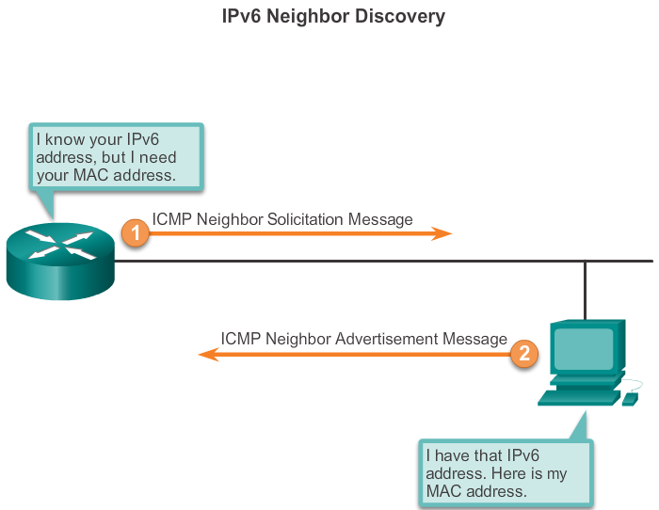
IPv6 ACL Creation Comparing IPv4 and IPv6 ACLs
Although IPv4 and IPv6 ACLs are very similar, there are three significant differences between them.
Applying an IPv6 ACL
IPv6 uses the ipv6 traffic-filter command to perform the same function for IPv6 interfaces.
No Wildcard Masks
The prefix-length is used to indicate how much of an IPv6 source or destination address should be matched.
Additional Default Statements
permit icmp any any nd-na
permit icmp any any nd-ns
(Neighbor Discovery - Neighbor Advertisement (nd-na) and
Neighbor Discovery - Neighbor Solicitation (nd-ns) messages are permitted.
Notes:
9.6.1.2

Slide 59
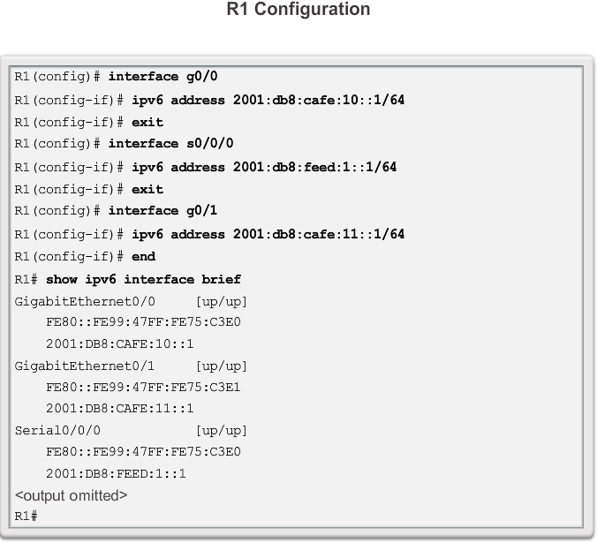
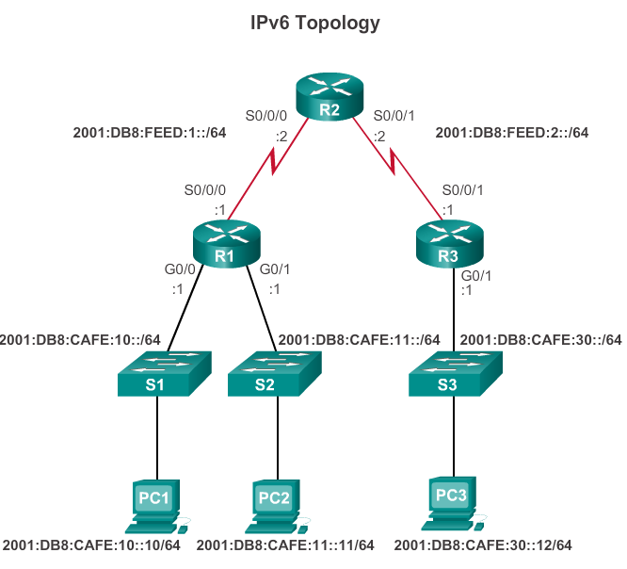
Configuring IPv6 ACLs Configuring IPv6 Topology
Notes:
9.6.2.1

Slide 60
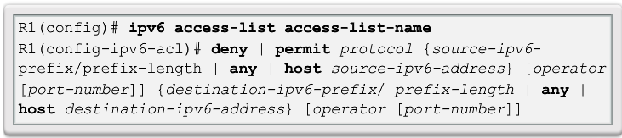
Configuring IPv6 ACLs Configuring IPv6 ACLs
There are three basic steps to configure an IPv6 ACL:
From global configuration mode, use the ipv6 access-list name command to create IPv6 ACL.
From the named ACL configuration mode, use the permit or deny statements to specify one or more conditions to determine if a packet is forwarded or dropped.
Return to privileged EXEC mode with the end command.
Notes:
9.6.2.2

Slide 61
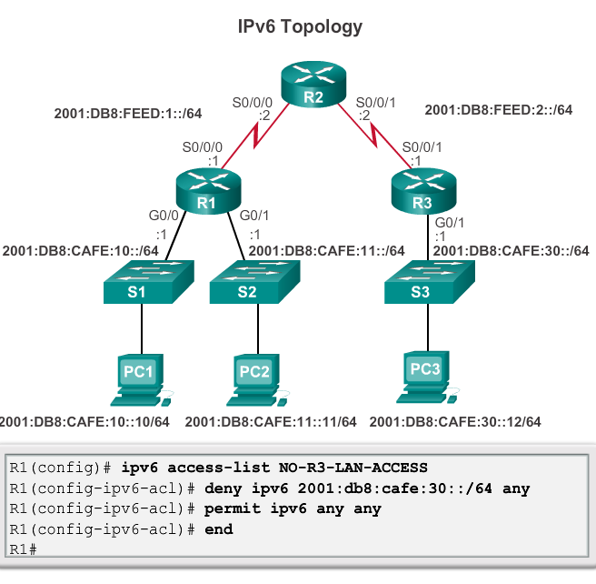
Configuring IPv6 ACLs
Example:
The first statement names the IPv6 access list NO-R3-LAN-ACCESS.
Similar to IPv4 named ACLs, capitalizing IPv6 ACL names is not required, but makes them stand out when viewing the running-config output.
The second statement denies all IPv6 packets from the 2001:DB8:CAFE:30::/64 destined for any IPv6 network. The third statement allows all other IPv6 packets.

Slide 62

Configuring IPv6 ACLs Applying an IPv6 ACL to an Interface
After an IPv6 ACL is configured, it is linked to an interface using the ipv6 traffic-filter command:
The figure shows the NO-R3-LAN-ACCESS ACL configured previously and the commands used to apply the IPv6 ACL inbound to the S0/0/0 interface. Applying the ACL to the inbound
S0/0/0 interface will deny packets from 2001:DB8:CAFE:30::/64 to both of the LANs on R1.
Notes:
9.6.2.3

Slide 63

Configuring IPv6 ACLs IPv6 ACL Examples
Example
An IPv6 ACL is configured to give the LAN on R3 limited access to the LANs on R1. Comments are added in the configuration to document the ACL.:
The first two permit statements allow access from any device to the web server at 2001:DB8:CAFE:10::10.
All other devices are denied access to the 2001:DB8:CAFE:10::/64 network.
PC3 at 2001:DB8:CAFE:30::12 is permitted Telnet access to PC2 which has the IPv6 address 2001:DB8:CAFE:11::11.
All other devices are denied Telnet access to PC2.
All other IPv6 traffic is permitted to all other destinations.
The IPv6 access list is applied to interface G0/0 in the inbound direction, so only the 2001:DB8:CAFE:30::/64 network is affected.
Notes:
9.6.2.4

Slide 64


Configuring IPv6 ACLs Verifying IPv6 ACLs
Notes:
9.6.2.5

Slide 65


